Slide 1

Detecting Recon Attacks
on IoT Devices
// Domenico Fumagalli

Slide 2
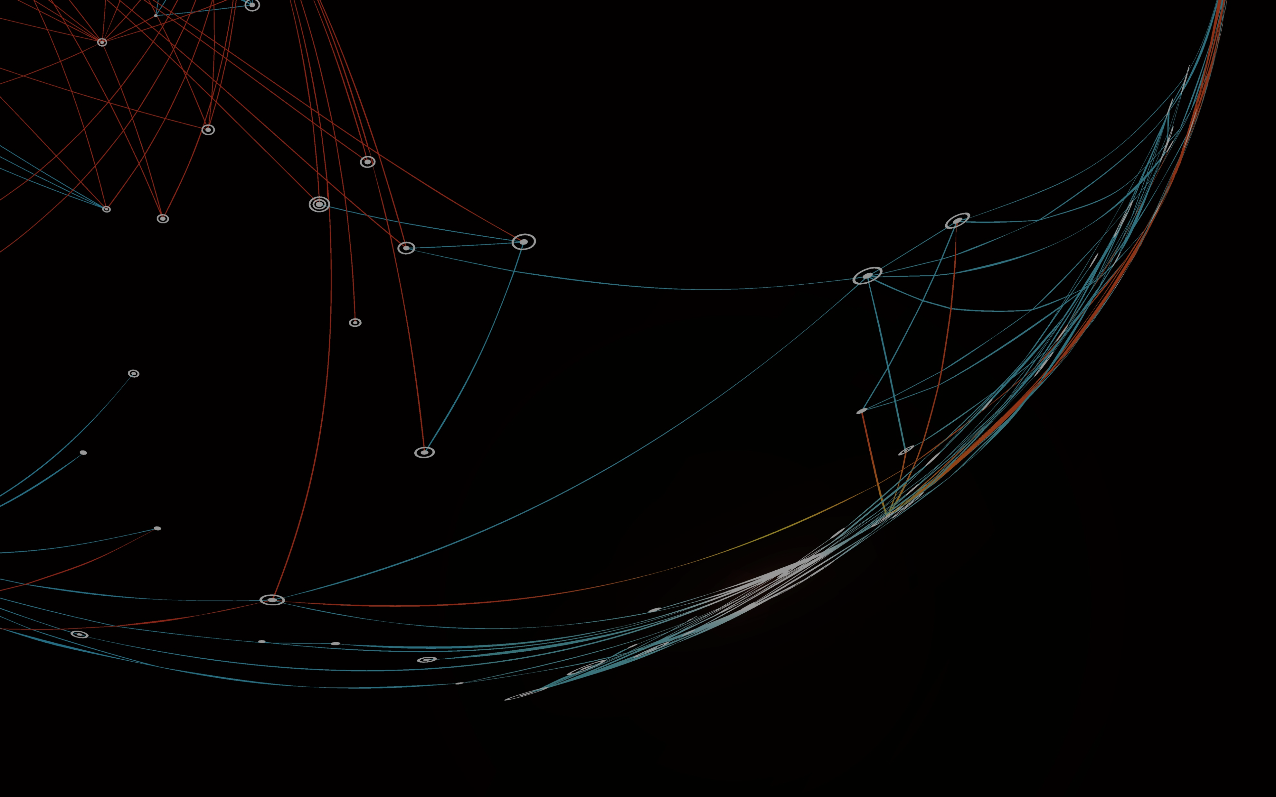
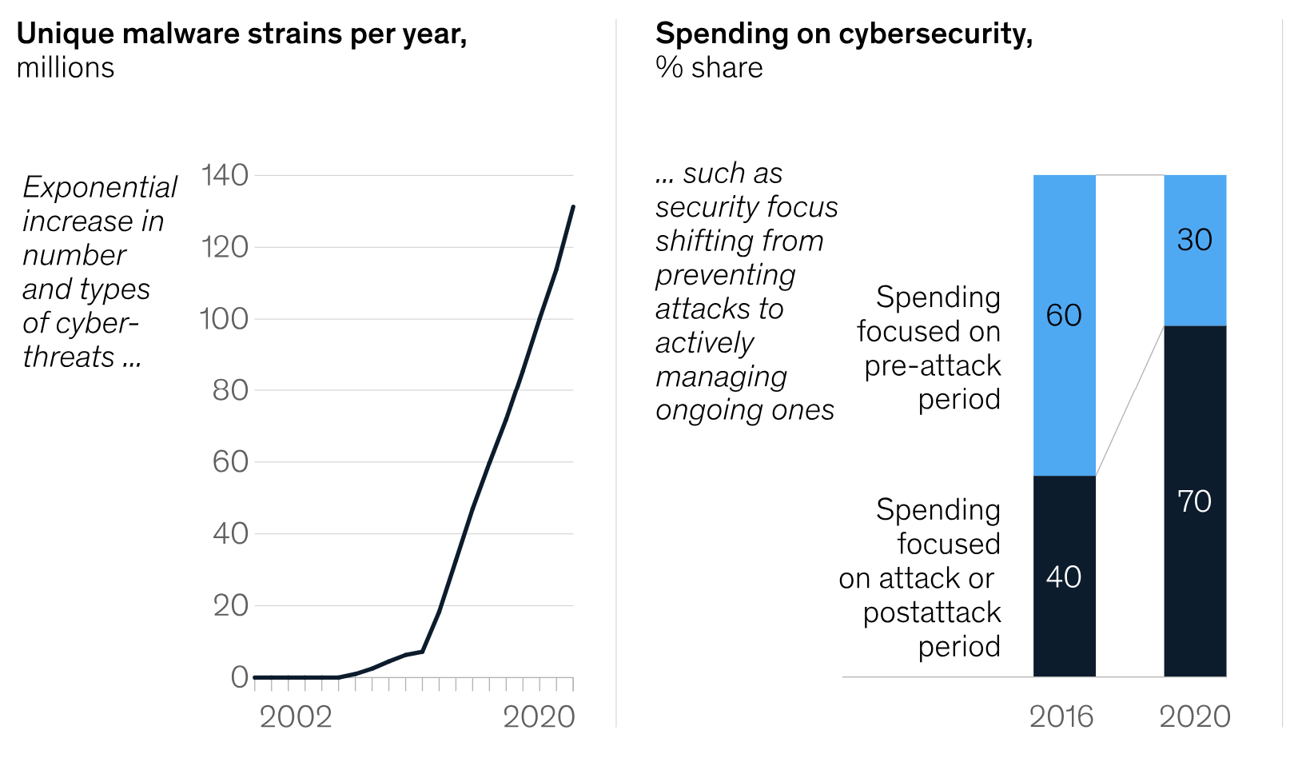
Our problem
2020
2025
Global data generated by IoT Devices
Global data generated by IoT Devices
17.3 ZB
73.1 ZB
We innovate through IoT.
We kinda need this.
The most extensive the networks, the more vulnerable they become.
Data Science is one piece of how we can secure them.

Slide 3

However:
// Network data is just huge
// Attack dynamics are complex
// Detection needs to be fast
We can:
// Monitor the network traffic
// Detect anomalies
// Respond to threat

Slide 4




The Dataset
The CICIOT2023 dataset from West Brunswick University is basically the result of an “in lab” cybersecurity experiment.
The network is reproduced in a lab and consists of 105 IoT devices.
In order to gather network traffic data from actual different kinds of cyberattacks, 33 different cyberattack has been performed on the network and its devices.
Thanks to the way the network is arranged the researchers were able to label the data with the kind of cyberattack being performed.
47 features
40 M rows

Slide 5
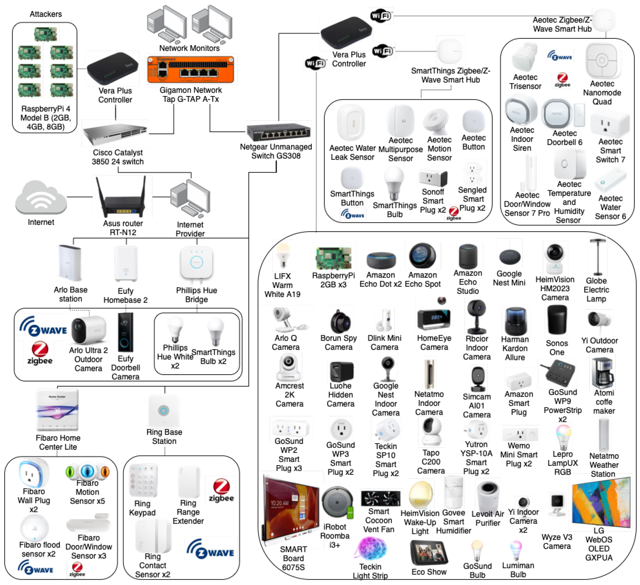
The IoT Topology

Slide 6
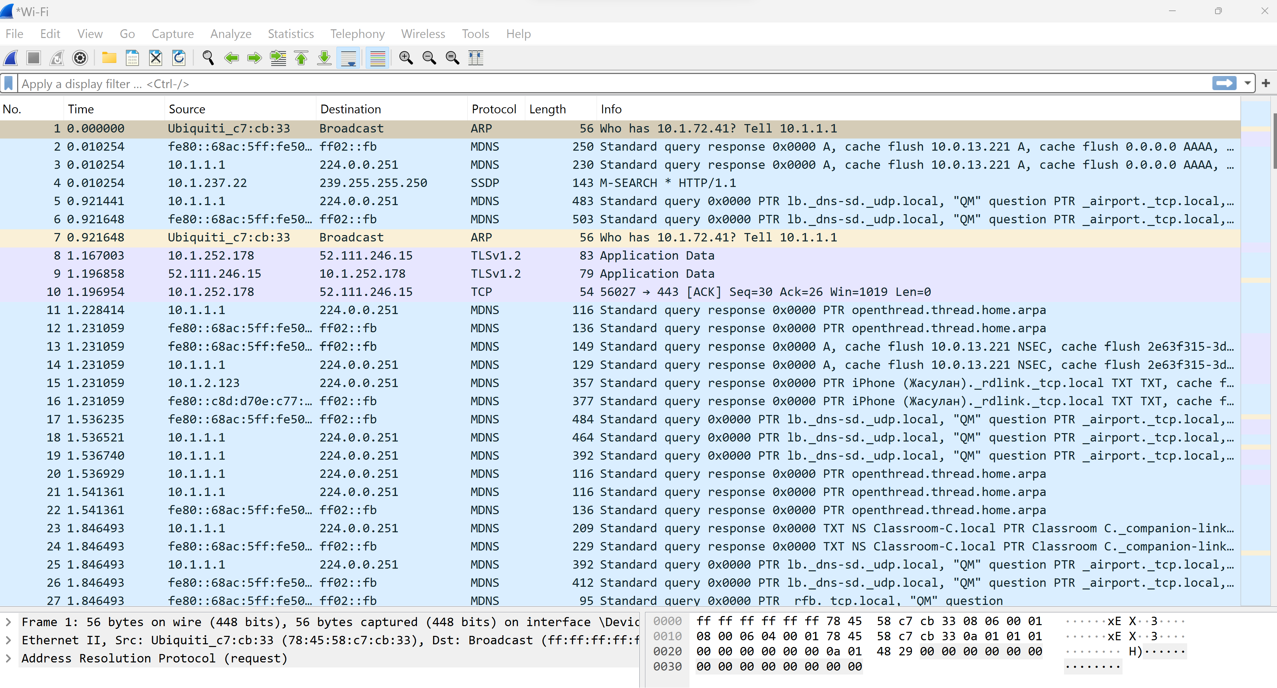
What is WireShark?

Slide 7

The project
We will focus on the task of individuating Recon Attacks as they are the typical first step of the most severe cyberattacks.
Understand the “Attack Surface” to react better.
Focusing on 6 classes vs 33 can lead to better results and optimization vs the research baseline
So far we have executed:
// Loading
// Processing
// Initial feature engineering
// Initial EDA

Slide 8
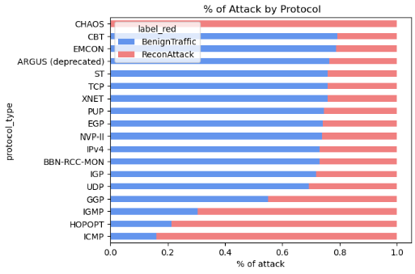
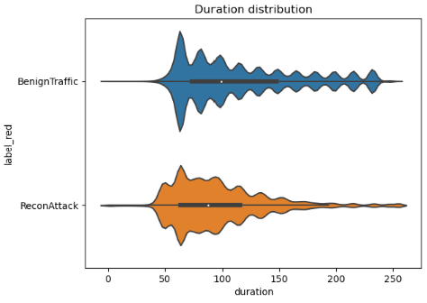
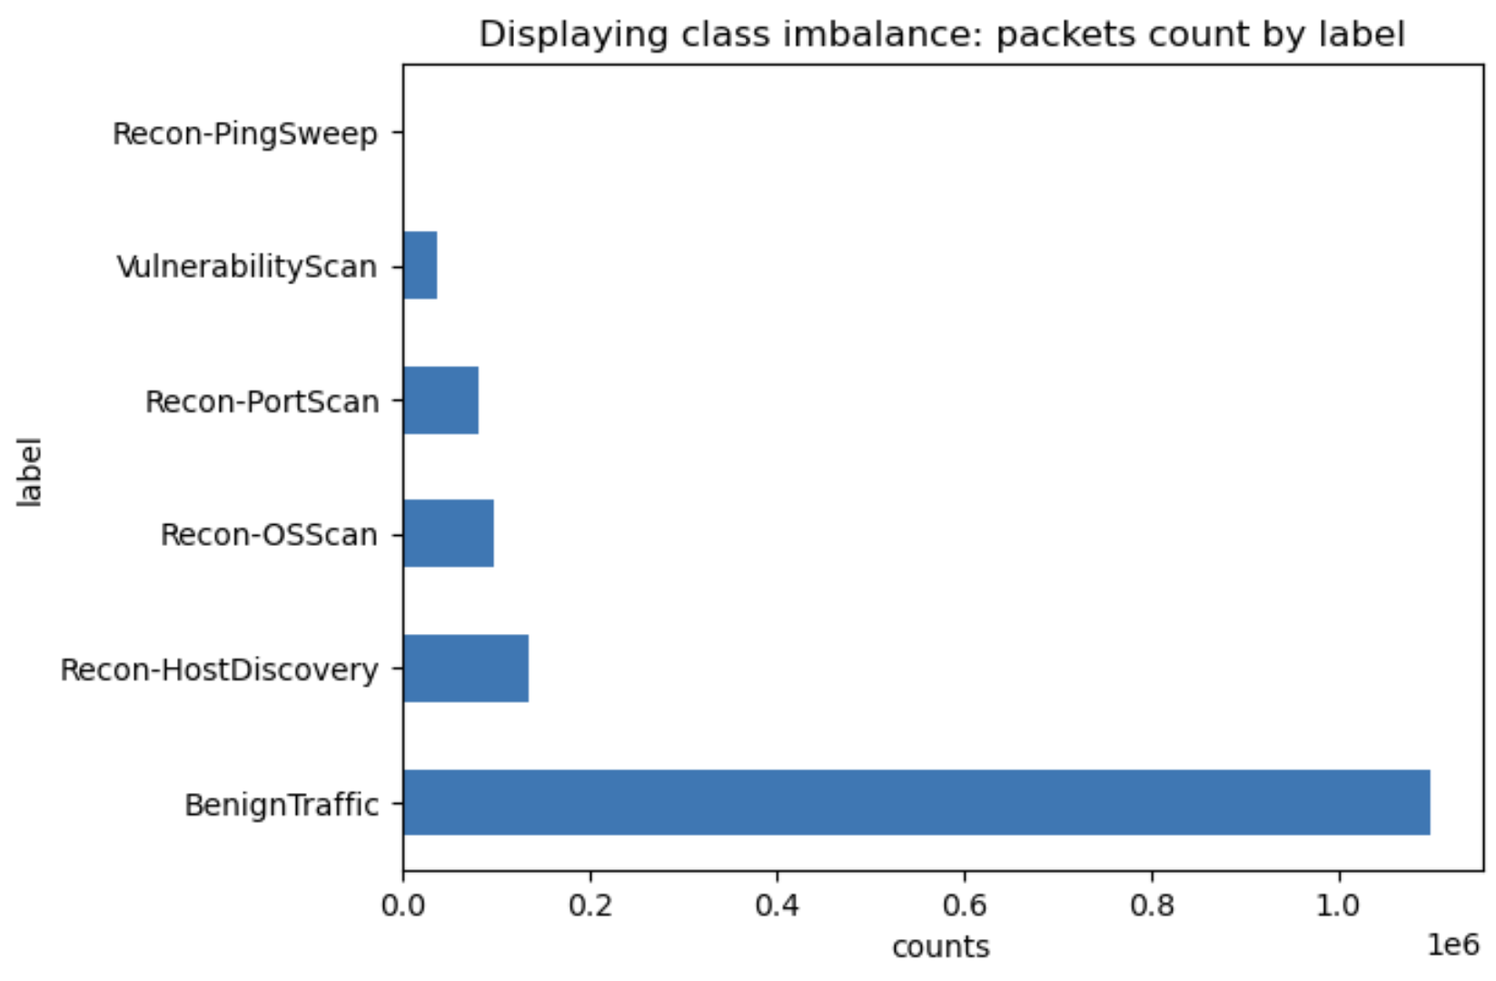
EDA Highlights

Slide 9
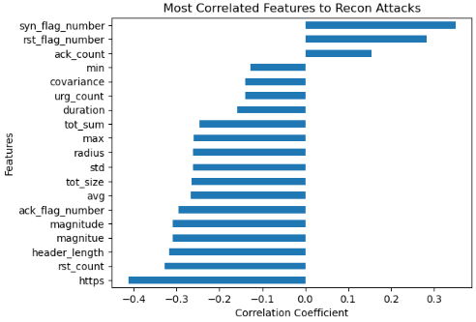
EDA Highlights
There’s a lot going on
Much of this is really not linear
Flows behavior changes due to the kind of attack as well
Deep Learning seems to be natural choice, but we’ll start from simplest models
Next Steps:
// Scaling
// Addressing class imbalance
// PCA and feature selection

